Slide 1
19CSE202 Database Mangement Systems Enhanced-E-R Diagram

Slide 2
Contents
Reducing E-R Diagrams to Relational Schemas
Entity-Relationship Design Issues
Extended E-R Features

Slide 3
Reducing E-R Diagrams to Relational Schemas

Slide 4
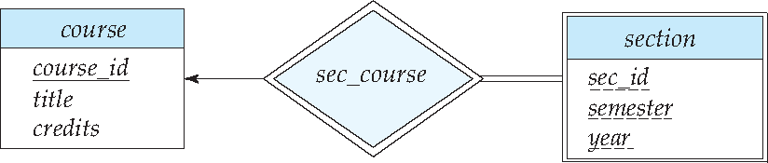
Reduction to Relation Schemas
Entity sets and relationship sets can be expressed uniformly as relation schemas that represent the contents of the database.
A database which conforms to an E-R diagram can be represented by a collection of schemas.
For each entity set and relationship set there is a unique schema that is assigned the name of the corresponding entity set or relationship set.
Each schema has a number of columns (generally corresponding to attributes), which have unique names.

Slide 5
Database Modeling and Implementation Process
Ideas
ER Design
Relational Schema
Relational DBMS
Implementation

Slide 6
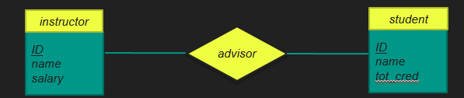
Representing Entity Sets
A strong entity set reduces to a schema with the same attributes
student(ID, name, tot_cred)
instructor(ID, name, salary)
A weak entity set becomes a table that includes a column for the primary key of the identifying strong entity set
section ( course_id, sec_id, sem, year )

Slide 7
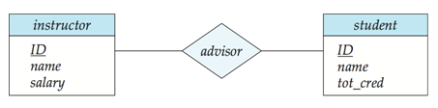
Representing Relationship Sets
A many-to-many relationship set is represented as a schema with attributes for the primary keys of the two participating entity sets, and any descriptive attributes of the relationship set.
Example: schema for relationship set advisor
advisor (s_id, i_id)

Slide 8
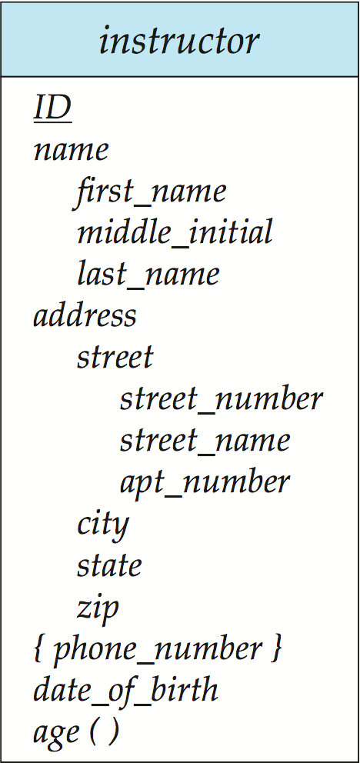
Representation of Entity Sets with Composite Attributes
Composite attributes are flattened out by creating a separate attribute for each component attribute
Eg.:For entity set instructor with composite attribute name with component attributes first_name, middle_initial and last_name the schema corresponding to the entity set has three attributes name_first_name, name.middle_initial and name_last_name
Prefix omitted if there is no ambiguity (name_first_name could be first_name)
Ignoring multivalued attributes, extended instructor schema is
instructor(ID, first_name, middle_initial, last_name, street_number, street_name, apt_number, city, state, zip, date_of_birth)
Notes:
8

Slide 9
Representation of Entity Sets with Multivalued Attributes
A multivalued attribute M of an entity E is represented by a separate schema EM.
Schema EM has attributes corresponding to the primary key of E and an attribute corresponding to multivalued attribute M.
Eg.: Multivalued attribute phone_number of instructor is represented by a schema: inst_phone= ( ID, phone_number)
Each value of the multivalued attribute maps to a separate tuple of the relation on schema EM
For example, an instructor entity with primary key 22222 and phone numbers 456-7890 and 123-4567 maps to two tuples: (22222, 456-7890) and (22222, 123-4567)
Notes:
9

Slide 10
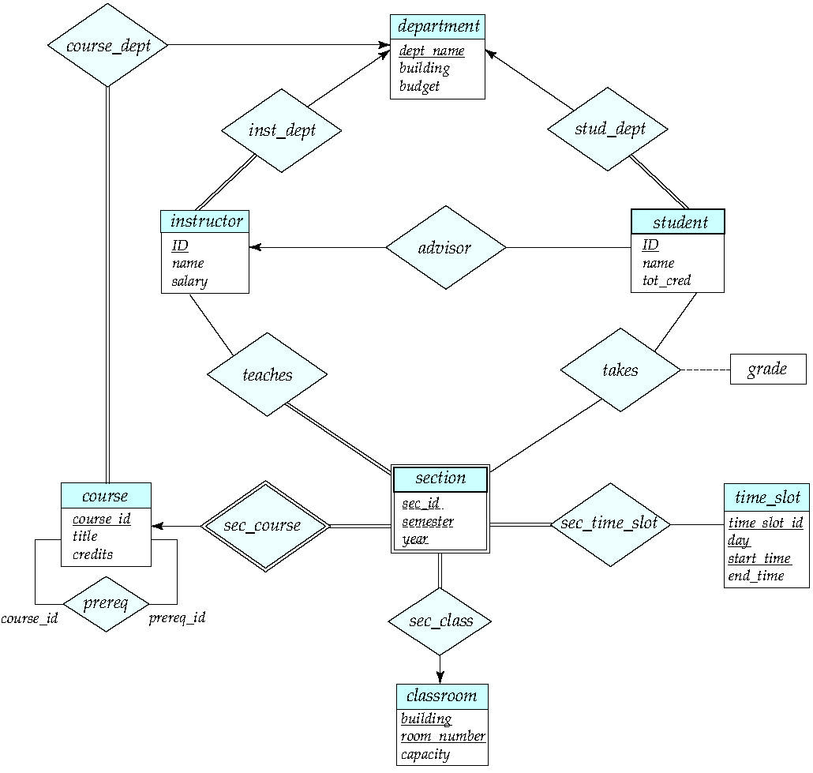
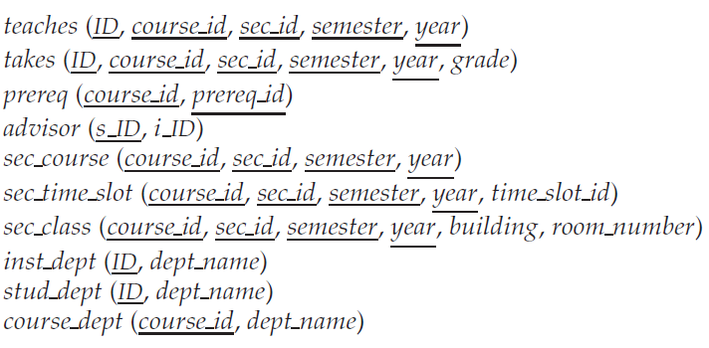
Suitable foreign key to be set
Eg,. Advisor (S_ID references student, i_ID references instructor)

Slide 11
Redundancy of Schemas
Many to one
No descriptive attributes
After reducing
course(course_id, title, credits)
Section(Course_id, sec_id, Semester, year)
Sec_course(Course_id, sec_id, Semester, year)

Slide 12
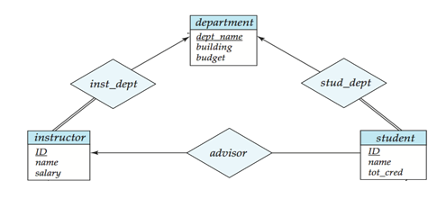
Redundancy of Schemas Combining the Schemas
Many-to-one and one-to-many relationship sets that are total on the many-side can be represented by adding an extra attribute to the “many” side, containing the primary key of the “one” side.
Example: Instead of creating a schema for relationship set inst_dept, add an attribute dept_name to the schema arising from entity set instructor

Slide 13
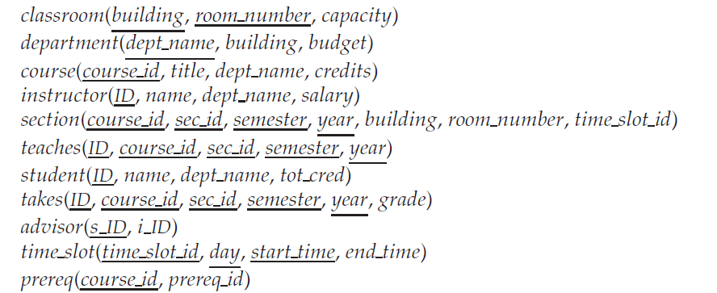
Refer
Instructor and Inst_dept
Student and stud_dept
Course and course_dept
Section and sec_class
Section and sec_time_slot
The foreign key to be maintained

Slide 14
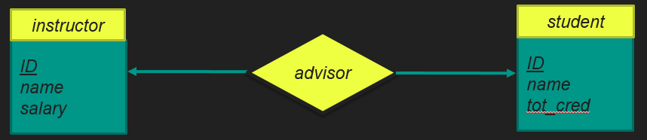
Redundancy of Schemas (Cont.)
For one-to-one relationship sets, the relation schema can be combined with either side of the entity sets.
That is, an extra attribute can be added to either of the tables corresponding to the two entity sets
instructor(Ins_ID, name, salary, Stud_id)
or student(stud_id, name, tot_cred, Ins_ID)
Notes:
14

Slide 15
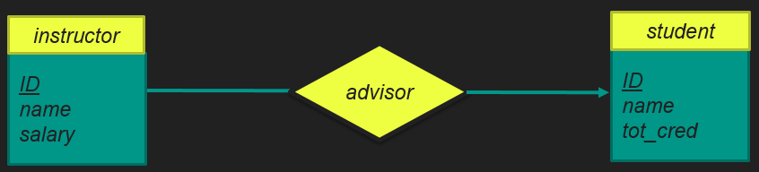
Redundancy of Schemas (Cont.)
If participation is partial on the “many” side, replacing a schema by an extra attribute in the schema corresponding to the “many” side could result in null values.
Instructor(Ins_ID, name, salary, stud_ID)

Slide 16
Design Issues

Slide 17
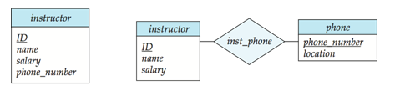
Entities vs. Attributes
Use of entity sets vs. attributes
Use of phone as an entity allows extra information about phone numbers (plus multiple phone numbers)
Notes:
17

Slide 18
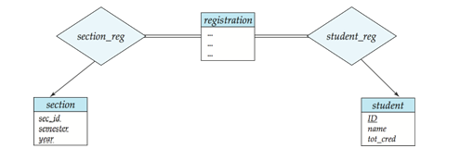
Entities vs. Relationship sets
Use of entity sets vs. relationship sets
Possible guideline is to designate a relationship set to describe an action that occurs between entities
Student -------- Takes ---------- Section
(or)
Notes:
18

Slide 19
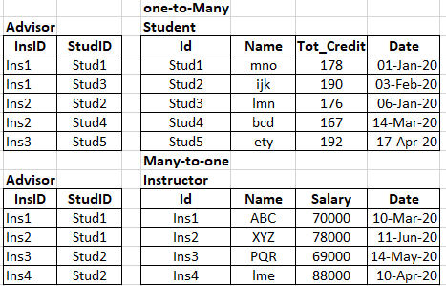
Placement of relationship set attributes
For example, attribute date as attribute of advisor or as attribute of student
Instructor ---- Advisor ---- Student Advisor(Ins_Id, Stud_Id, Date)
|
(Date)
The Cardinality of the advisor can be used to decide.
If Many-to-One or one-to-many
Keep in “many” side.

Slide 20
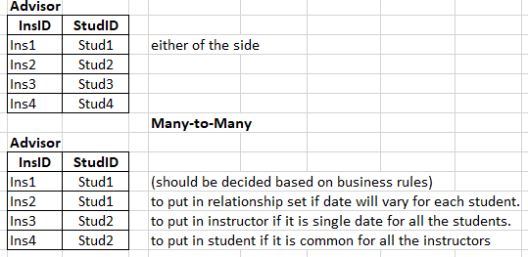
Placement of relationship attributes
For example, attribute date as attribute of advisor or as attribute of student
Instruction ---- Advisor ---- Students Advisor(Ins_Id, Stud_Id, Date)
|
(Date)
The Cardinality of the advisor can be used to decide.
If one-to-one
Keep in either of the side.
If many-to-many
Use Business rule.

Slide 21
Binary Vs. Non-Binary Relationships
Although it is possible to replace any non-binary (n-ary, for n > 2) relationship set by a number of distinct binary relationship sets, a n-ary relationship set shows more clearly that several entities participate in a single relationship.
Some relationships that appear to be non-binary may be better represented using binary relationships
Child
|
Father ….R… Mother
Child Child
| |
F M
| |
Father Mother
For example, a ternary relationship parents, relating a child to his/her father and mother, is best replaced by two binary relationships, father and mother.
Using two binary relationships allows partial information (e.g., only mother being known)
But there are some relationships that are naturally non-binary
Example: proj_guide
Notes:
21

Slide 22
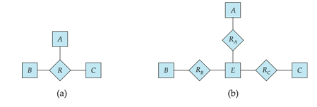
Converting Non-Binary Relationships to Binary Form
In general, any non-binary relationship can be represented using binary relationships by creating an artificial entity set.
Replace R between entity sets A, B and C by an entity set E, and three relationship sets:
1. R_{A}, relating E and A 2. R_{B}, relating E and B 3. R_{C}, relating E and C
Create an identifying attribute for E and add any attributes of R to E
For each relationship (a_{i} , b_{i} , c_{i}) in R, create
1. a new entity e_{i} in the entity set E 2. add (e_{i} , a_{i} ) to R_{A}
3. add (e_{i} , b_{i} ) to R_{B} 4. add (e_{i} , c_{i} ) to R_{C}
Notes:
22

Slide 23
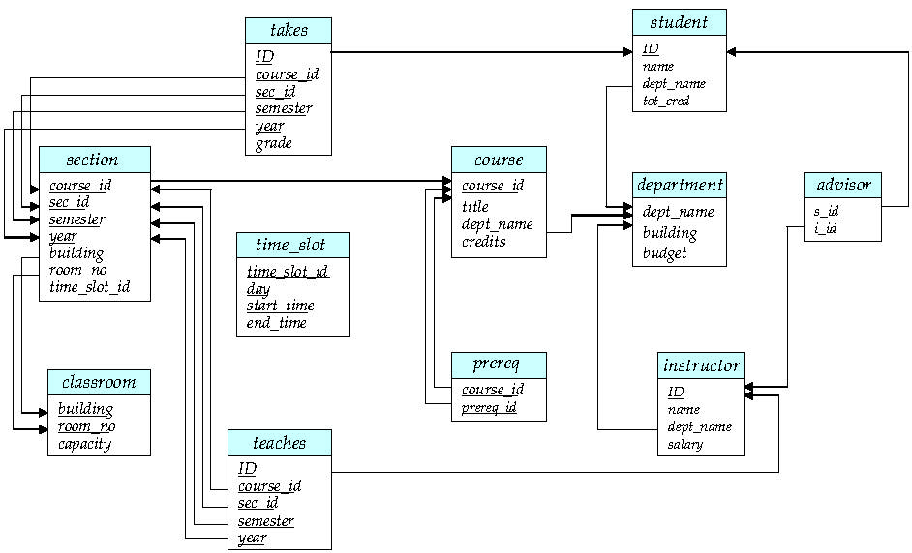
Schema Diagram

Slide 24
Extended ER Features

Slide 25
Specialization
Top-down design process- we designate sub-groupings within an entity set that are distinctive from other entities in the set.
These sub-groupings become lower-level entity sets.
The subgroupings have attributes, they participate in relationships that do not apply to the higher-level entity set.
Depicted by a triangle component labeled ISA (e.g., instructor “is a” person).

Slide 26
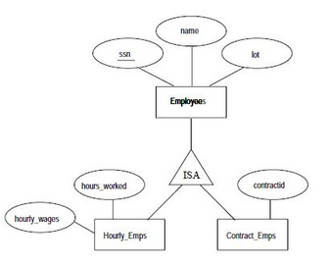
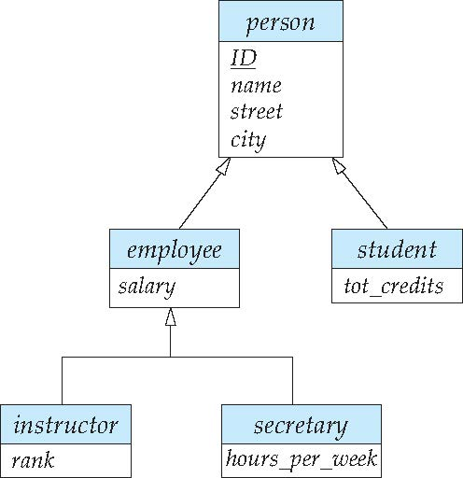
Specialization Example
Overlapping – employee and student
Disjoint – instructor and secretary
Attribute inheritance – a lower-level entity set inherits all the attributes and relationship participation of the higher-level entity set to which it is linked.
(Superclass-Subclass Relationship)
What is seen above is single inheritance.
If an entity set is a lower-level entity set in more than one ISA relationship, then the entity set has multiple inheritance, and the resulting structure is said to be a lattice.

Slide 27
Generalization
A bottom-up design process – Combine a number of entity sets that share the same features into a higher-level entity set.
Specialization and generalization are simple inversions of each other; they are represented in an E-R diagram in the same way.
The terms specialization and generalization are used interchangeably.

Slide 28
Whether a given portion of an E-R model was arrived at by specialization or generalization, the outcome is basically the same:
• A higher-level entity set with attributes and relationships that apply to all of its lower-level entity sets.
• Lower-level entity sets with distinctive features that apply only within a particular lower-level entity set.

Slide 29
Representing Specialization via Schemas
Method 1:
Form a schema for the higher-level entity
Form a schema for each lower-level entity set, include primary key of higher-level entity set and local attributes
Drawback: getting information about, an employee requires accessing two relations, the one corresponding to the low-level schema and the one corresponding to the high-level schema
schema attributes
person ID, name, street, city
student ID, tot_cred
employee ID, salary
Notes:
29

Slide 30
Representing Specialization as Schemas (Cont.)
Method 2:
Form a schema for each entity set with all local and inherited attributes
Drawback: name, street and city may be stored redundantly for people who are both students and employees
schema attributes
person ID, name, street, city
student ID, name, street, city, tot_cred
employee ID, name, street, city, salary
Notes:
30

Slide 31
Design Constraints on a Specialization/Generalization
Constraint #1 - determining which entities can be members of a given lower-level entity
(1) Condition Defined – The membership is evaluated on the basis of whether or not an entity satisfies an explicit condition or predicate.
Eg. Student(ID, Name, StudentType)
if StudentType=‘UG’ then UG_Student
if StudentType=‘PG’ then PG_Student
it is also called as ‘Attribute defined’
(2) User Defined – Database designer decide the membership of the entities to the lower entity sets.
Eg. Grouping employees in to different teams, for a purpose.

Slide 32
Design Constraints on a Specialization/Generalization
Constraint #2 – whether or not the entities belong to more than one lower level entity sets.
Disjoint constraint – Each entity belongs to only one of the lower level entity set.
Eg. ‘Student’ based on Student_Typer either is UG or PG.
Overlapping Constraint - The entities may belong to more one lower level entity sets.
Eg. ‘Employee’ each employee may work in multiple teams.
‘Student’ each student may belongs to different elective groups/

Slide 33
Design Constraints on a Specialization/Generalization
Constraint #3 - Completeness constraint - Specifies whether or not an entity in the higher-level entity set must belong to at least one of the lower-level entity sets within a generalization.
Total specialization/generalization : an entity must belong to one of the lower-level entity sets.
Partial specialization/generalization : an entity need not belong to one of the lower-level entity sets.
‘Partial generalization is the default’

Slide 34
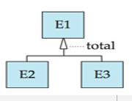
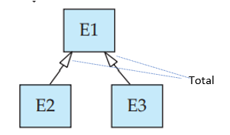
Total generalization in ER diagram:
Add the keyword total in the diagram and draw a dashed line from the keyword to the corresponding hollow arrow-head (for a total generalization), or to the set of hollow arrow-heads (for an overlapping generalization).
Eg. Student specialization to under graduate or post graduate is total.
Student specialization to under graduate or post graduate is total and disjoint.
Employee specialization to different teams is partial and overlapping.

Slide 35
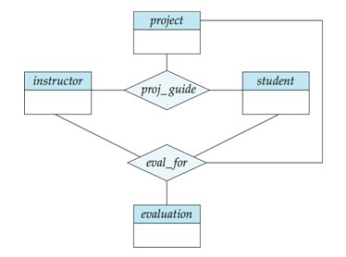
Aggregation
One limitation of the E-R model is that it cannot express relationships among relationships.
Consider the ternary relationship proj_guide
Suppose we want to record evaluations of a student by a guide on a project

Slide 36
Aggregation (Cont.)
Relationship sets eval_for and proj_guide represent overlapping information
Every eval_for relationship corresponds to a proj_guide relationship
However, some proj_guide relationships may not correspond to any eval_for relationships
So we can’t discard the proj_guide relationship
Eliminate this redundancy via aggregation
Treat relationship as an abstract entity
Allows relationships between relationships
Abstraction of relationship into new entity

Slide 37
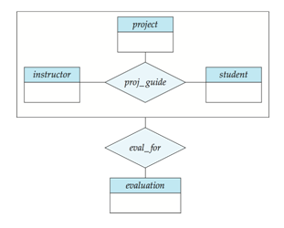
Aggregation (Cont.)
The diagram represents:
A student is guided by a particular instructor on a particular project
A student, instructor, project combination may have an associated evaluation
Notes:
37

Slide 38
Representing Aggregation via Schemas
To represent aggregation, create a schema containing
Primary key of the aggregated relationship,
The primary key of the associated entity set
Any descriptive attributes
In our example:
The schema eval_for is:
eval_for (s_ID, project_id, i_ID, evaluation_id)

Slide 39
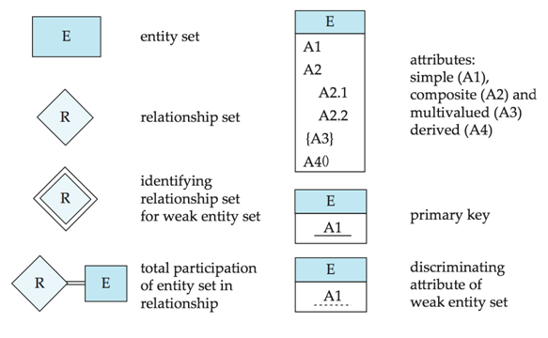
Summary of Symbols Used in E-R Notation

Slide 40
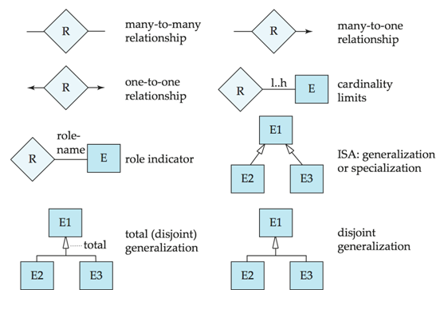
Symbols Used in E-R Notation (Cont.)

Slide 41
Alternative Notations for Modeling Data

Slide 42
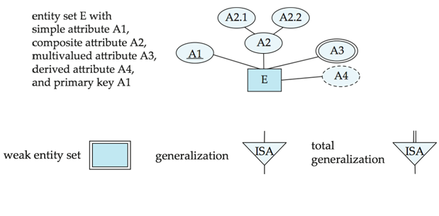
Alternative ER Notations

Slide 43
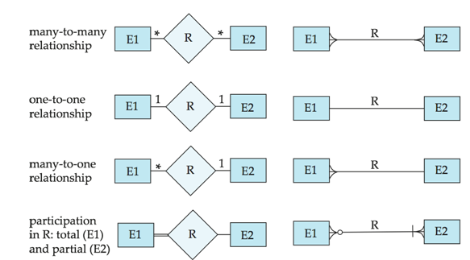
Alternative ER Notations
Chen IDE1FX (Crows feet notation)

Slide 44
UML
UML: Unified Modeling Language.
UML has many components to graphically model different aspects of an entire software system.
UML Class Diagrams correspond to E-R Diagram, but there are several differences.

Slide 45
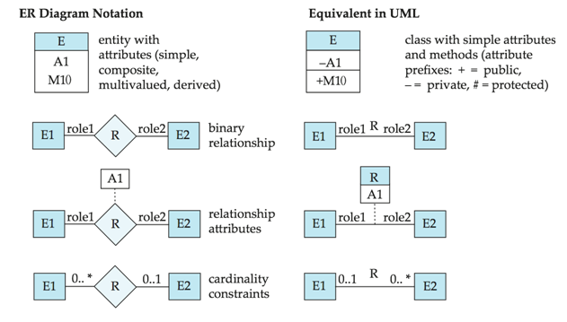
ER vs. UML Class Diagrams
*Note reversal of position in cardinality constraint depiction

Slide 46
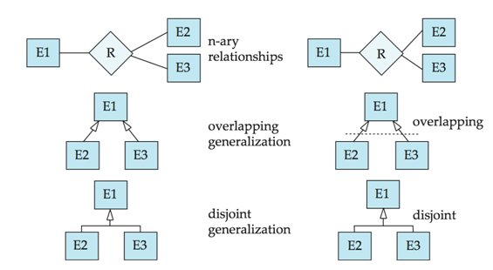
ER vs. UML Class Diagrams
ER Diagram Notation
Equivalent in UML
*Generalization can use merged or separate arrows independent
of disjoint/overlapping

Slide 47
UML Class Diagrams (Cont.)
Binary relationship sets are represented in UML by just drawing a line connecting the entity sets. The relationship set name is written adjacent to the line.
The role played by an entity set in a relationship set may also be specified by writing the role name on the line, adjacent to the entity set.
The relationship set name may alternatively be written in a box, along with attributes of the relationship set, and the box is connected, using a dotted line, to the line depicting the relationship set.

Slide 48
ACTIVITY

Slide 49
Design the relation schemas for the E-R Diagram of University Enterprise shown in the next slide

Slide 51
Summary
Reducing E-R Diagrams to Relational Schemas
Extended E-R Features
Entity-Relationship Design Issues
Alternative Notations for Modeling Data
Activity: Relation Schema for E-R Diagram of University Enterprise

Slide 52
Thank You
Happy to answer any questions ! ! !
Notes:
Not covering all.

Slide 53
Resources:
Text Book:
Silberschatz A Korth H F and SudharshanS , “Database System Concepts”, 6th Edition, TMH publishing company limited, 2011.
7th edition of text book is released in 2019 https://www.db-book.com/db7/index.html
6th edition Textbook Link https://www.db-book.com/db6/index.html
References:
Hector Garcia-Molina, Jeffrey D Ullman, JennierWidom, ‘Database System ; The complete book”, 2nd Edition, 2011.
Elmasri R and Navathe S B, “Fundamentals of Database Systems”, 5th Edition, Addison Wesley, 2006.
Ramakrishnan R and Gehrke J, “Database Management Systems”, 3rd Edition, TMH, 2003

